Slide 1
Basic Network Cryptography
Symmetric encryption, public-key encryption, key distribution, authentication, digital signature, X.509 certificates
Online Material

Slide 2


Why?
Data confidentiality
Privacy
Data Integrity
System Integrity
Availability

Slide 3
Security Attacks
Passive Attacks
Learn or make use of information from the system but does not affect system resources.
“Evesdropping”
Active Attacks
Attempts to alter system resources or affect their operation
“Engaging”

Slide 4
Terminology
Plaintext
The original message or data that is fed into the algorithm as input.
Encryption Algorithm
The encryption algorithm performs various operations on the plaintext.
Secret key
Input to the encryption algorithm that governs the operations.
Ciphertext
The scrambled message.
Decryption Algorithm
The decryption algorithm deciphers the ciphertext, using the secret key, and produces the original data.

Slide 5
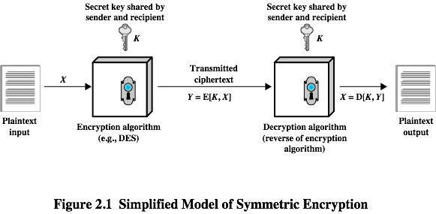
Symmetric Encryption

Slide 6
Requirements
Strong encryption algorithm
Secure distribution of key
The security of symmetric encryption depends on the secrecy of the key, not the secrecy of the algorithm.

Slide 7
Encryption Algorithms
Data Encryption Standard (DES) , 3DES or Triple DES
Introduced 1977, n*56-bit keys, block size 64 bit
Used in a lot of hardware
Blowfish
1993, Fast, public domain, keys 32—448-bit, block size 64 bit.
Twofish
1998, public domain, keys 128, 192, 256-bit, block size 128 bit.
Advanced Encryption Standard (AES)
Introduced 1998, 128,192, 256-bits, block size 128 bit.

Slide 8
Brute Force Attacks
Get a key
Key
Cipertext
Test
Failed
Solved

Slide 9
Brute Force Attacks
Get a key
Key
Test
Failed
Solved
Cipertext
Get a key
Key
Test
Failed
Solved
Get a key
Key
Test
Failed
Solved

Slide 10
Average time for exhaustive key search

Slide 11
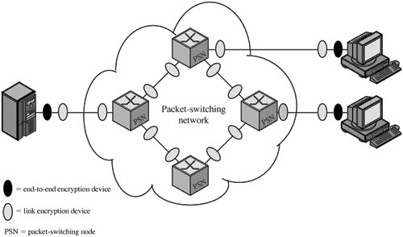
Location of Encryption Devices
Link encryption device
End-to-end encryption device

Slide 12
Key Distribution -- Symmetric
A key can be selected by A and physically distributed to B
A third party could select the key and physically delivered to A and B
If A and B have previously and recently used a key, one party could transmit the new key to the other, encrypted using the old key.
If A and B each have an encrypted connection to a third-party C, C could deliver a key on the encrypted links to A or B.

Slide 13
Automatic Key Distribution
Key distribution center
Application
Application
Sec.
service
Sec.
service

Slide 14
Message Authentication
Encryption protects against passive attacks.
Message authentication can prevent against active attacks.
Authentication Using Symmetric Encryption
Encrypt(Message+time,key)
Time/Resource consuming
Message Authentication without Message Encryption
Ensure message has not been changed.
Broad/Multicast --- One Sender, multiple receivers
Load situation on receiver

Slide 15
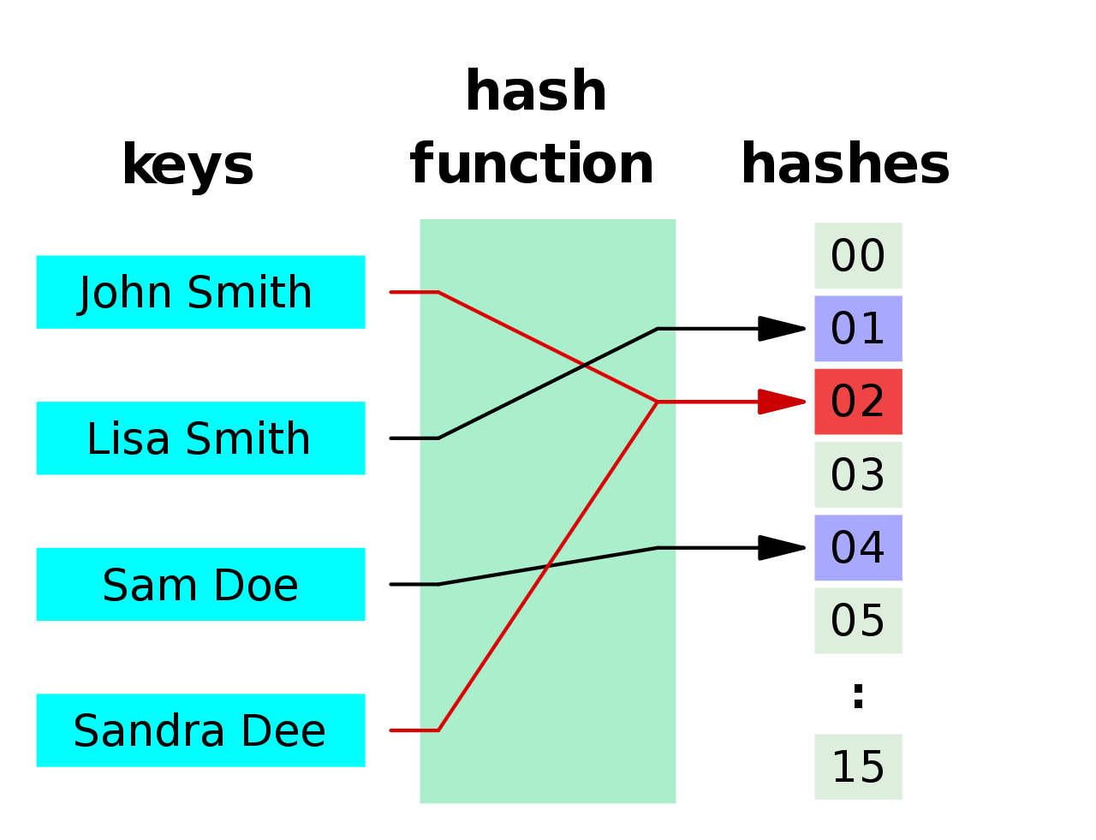
Hashing Algorithms
Maps data of arbitrary size to data of fixed size.
MD5
MD5 message-digest algorithm
Simple tampering…
SHA
Secure Hash Algorithm
SHA-1,SHA-2,SHA-3
SSL Certificates…

Slide 16

Public-key/Asymmetric Encryption
Proposed by Diffie and Hellman 1976.
Based on Mathematical functions.
Asymmetric.
Two keys.
key distribution
confidentiality
authentication.
The scheme has six ingredients
Plain-text
Encryption algorithm
Public key
Private key
Cipher text
Decryption algorithm
https://en.wikipedia.org/wiki/Public-key_cryptography

Slide 17
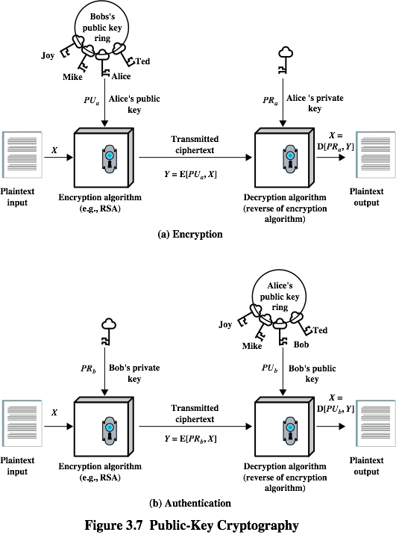
Encryption with public key

Slide 18
Encryption with private key: Digital Signature

Slide 19
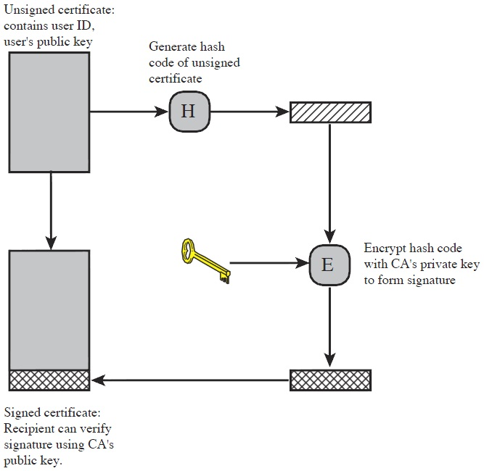
Key distribution using asymmetric encryption

Slide 20
Applications of asymmetric encryption
Encryption/decryption: The sender encrypts a message with the recipient’s public key.
Digital signature: The sender ”signs” a message with its private key.
Key exchange: Two sides co-operate two exchange a session key.

Slide 21
Key distribution
A key could be selected by A and physically delivered to B.
A third party could select the key and physically deliver it to A and B.
If A and B have previously used a key, one party could transmit the new key to the other, encrypted using the old key.
If A and B each have an encrypted connection to a thirdparty C, C could deliver a key on the encrypted links to A and B.
Session key
Data encrypted with a one-time session key. At the conclusion of the session the key is destroyed
Permanent key
Used between entities for the purpose of distributing session keys

Slide 22

Symmetric key distribution
Two parties must share same key
Protected from the access of others
Frequent key exchange to limit amount of data compromised
Key can be exchanged
Physical delivery to B
A third party physically deliver it to A and B
Re-usage of old key to exchange new key
A & B both communicate securely with C, C delivers the key
Option 1 & 2 require manual delivery
Option 3 requires link encryption or end-to-end encryption. What if old key is compromised?

Slide 23
Symmetric key distribution
For option 4 two kinds of keys are used
Session Key: One-time key
Permanent Key: for distributing session key.
Necessary element, Key Distribution Center (KDC): determines which systems are allowed to communicate with each other.
Operation of KDC
A wish to communicate B, transmits request to KDC. Communication is encrypted using a master key
KDC approves connection and creates one-time session key. Session key is encrypted with permanent keys of A & B and delivered to A & B.
A & B set up logical connection and uses session key.
Most widely application to use this approach is KERBEROS

Slide 24
Security concerns
Key concerns are confidentiality and timeliness
To provide confidentiality must encrypt identification and session key info which requires the use of previously shared private or public keys
Need timeliness to prevent replay attacks
Provided by using sequence numbers or timestamps or challenge/response

Slide 25
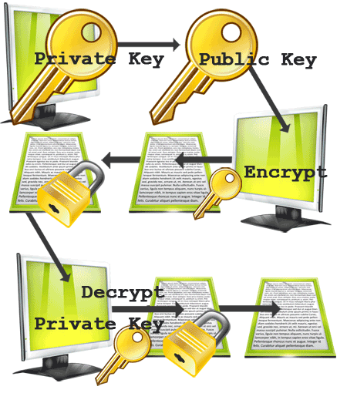
Key distribution using asymmetric encryption
Problem : The distribution of Public Keys
What if a fake user impersonate to be a legitimate user and distribute his keys
Solution : Public-Key Certificates
Consists of a public key + User ID of the key owner with whole block signed by a trusted third party
Third party is a Certificate Authority (CA), trusted by user community
User deliver public key to CA in a secure manner and obtain a certificate
User publish the certificate
Anyone needing this user’s public key can obtain the certificate and verify it by attached trusted signature
X.509 Certificates

Slide 26
X.509 certificates
Standard for a public key infrastructure (PKI)
Distributed set of servers that maintains a database about users.
Assumes a strict hierarchical system of certificate authorities (CAs) for issuing the certificates
Each certificate contains the public key of a user and is signed with the private key of a CA.
Is used in S/MIME, IP Security, SSL/TLS and SET.
RSA is recommended to use.

Slide 27
X.509 certificates
A certification authority issues a certificate binding a public key to a particular distinguished name
A certificate authority or certification authority (CA) is an entity which issues digital certificates for use by other parties. It is an example of a trusted third party. There are many commercial CAs that charge for their services. Institutions and governments may have their own CAs, and there are free CAs.
An organization's trusted root certificates can be distributed to all employees so that they can use the company PKI system
X.509 also includes standards for certificate revocation list (CRL) implementations

Slide 28
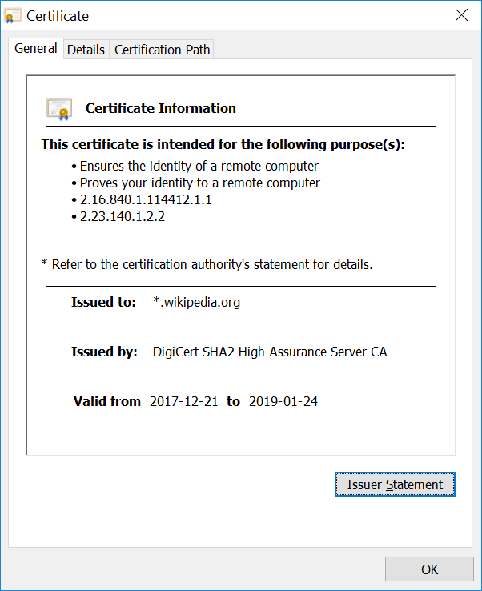
X.509 certificates

Slide 29
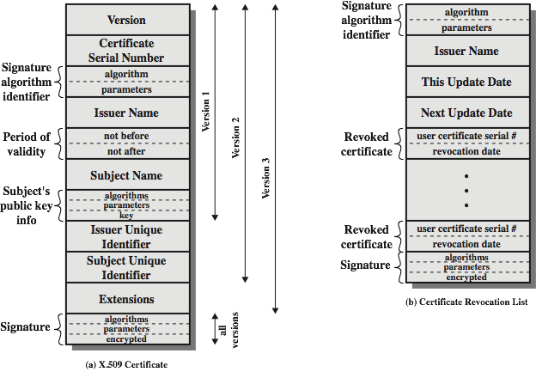
X.509 certificates

Slide 30
Obtaining a user’s certificate
Characteristics of certificates generated by CA:
Any user with access to the public key of the CA can recover the user public key that was certified.
No part other than the CA can modify the certificate without this being detected.

Slide 31
Revocation of certificates
Reasons for revocation:
The users secret key is assumed to be compromised.
The user is no longer certified by this CA.
The CA’s certificate is assumed to be compromised.

Slide 32
Sources
Network Security Essentials
W. Stallings
Computer Networks with Internet Protocols and Technology
W. Stallings
Computer Networking A Top-Down approach
J. F. Kurose, K. W. Ross

